Slide 1

HAZARD IDENTIFICATION AND DETECTION USING MACHINE LEARNING APPROACH
Guided by
Dr. A. MARY SOWJANYA
Associate Professor
Submitted by
B.V.S. PAVAN KUMAR
(321206416001)

Slide 2
Index
Abstract
Existing Method
Proposed system
Problem Statement
Methodology
Implementation
Results
Conclusion and Future work

Slide 3
Abstract
Internet surfing has become a vital part of our daily life. So to catch the attention of the user’s different browser vendors compete to set up the new functionality and advanced features that become the source of attacks for the intruder and the websites are put at hazard. Hazards, encompassing potential threats and risks that can lead to harm or adverse events, necessitate proactive measures for timely intervention.
However, the existing approaches are not adequate to protect the surfers which require an expeditious and precise model that can be able to distinguish between the benign or malicious webpages.

Slide 4
In this project, I developed a new classification system to analyse and detect the malicious web pages using machine learning classifiers such as, Decision tree,K-Neighbors, XG Boost, Ada Boost, Random Forest, Extra tree classifiers and Some special URL (Uniform Resource Locator) based on extricated features the classifiers are trained to predict the malicious webpages.
The experimental results have shown that the performance of the random forest classifier achieves better accuracy of 95% in comparison to other machine learning classifiers.
Achieving a higher classification accuracy is crucial in enhancing web security and protecting users from potential cyber threats.

Slide 5
Existing System
Existing systems typically detect malicious URLs of a single attack type. In this project, I propose some methods using machine learning to detect malicious URLs of all the popular attack types and identify the nature of attack a malicious URL attempts.

Slide 6
Proposed system
The proposed method uses a variety of discriminative features including textual properties, link structures, webpage contents, DNS information, and network trafﬁc. Many of these features are novel and highly effective. In the experimental studies with 40,000 benign URLs and 32,000 malicious URLs obtained from real-life Internet.
I also report the studies on the effectiveness of each group of discriminative features, and discuss their readability.

Slide 7
Problem Statement
Utilizing machine learning classifiers like Decision Tree, XGBoost, Ada Boost, KNN, Random Forest, Extra tree classifiers to determine whether a specific website is harmful or safe. The objective is to predict the website's nature by analysing its characteristics and content.
These classifiers will be employed to distinguish between malicious websites and benign ones based on their features. By leveraging these machine learning algorithms, my aim to create a model capable of efficiently identifying potential threats and protecting users from harmful online experiences.

Slide 8
Methodology
Step 1 :
According to my requirements, I have imported packages and downloaded a dataset from the internet source contains both the malicious and benign web sites.
Step 2 :
I have designed a dataset consisting of 7 URL features and 1782 records. Then I manually divide the dataset into two sets; one is for training set made up of 812 records and another is for testing set consists of 970 records.
Step 3 :
Machine learning classifiers are trained to create a Machine Learning (ML) model with the help of the training set.
Step 4 :
The ML model is verified with the testing set to obtain required result. If the Type attribute value contains 0 means the inputted URL is a benign web site else it is a malicious web site.

Slide 9
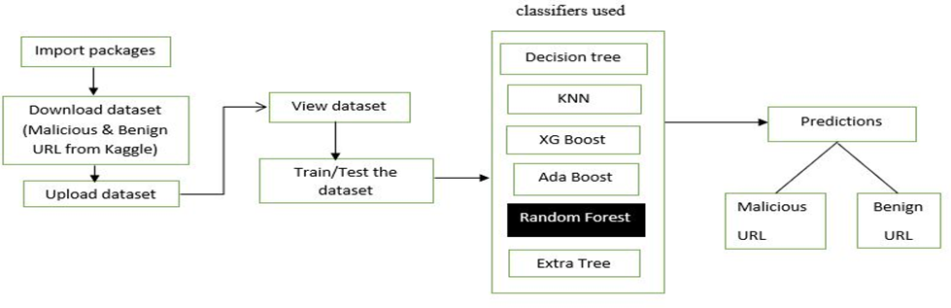
Block Diagram

Slide 10
Implementation
Take dataset:
Take the dataset from the user.
View dataset:
The uploaded dataset is viewed by the user.
Train/test dataset:
System can give training to the dataset.

Slide 11
Model performance:
The three main metrics used to evaluate a classification model are accuracy, precision, and recall. Accuracy is defined as the percentage of correct predictions for the test data. It can be calculated easily by dividing the number of correct predictions by the number of total predictions.
Predictions:
Using the machine leaning algorithms, I can predict the result.
Graphs:
Graphs can be generated by the system and the user can be view that graphs.

Slide 12

Results

Slide 13
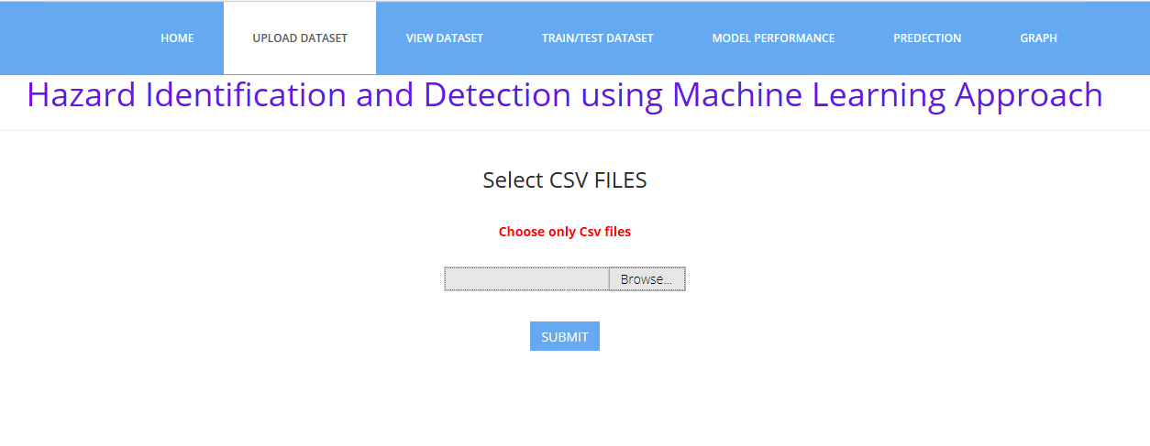
Upload dataset

Slide 14
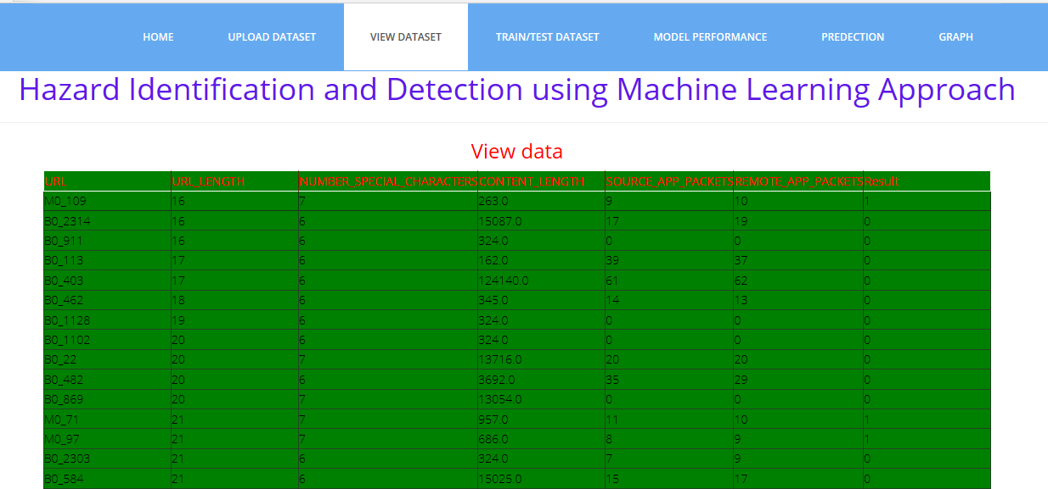
View dataset

Slide 15
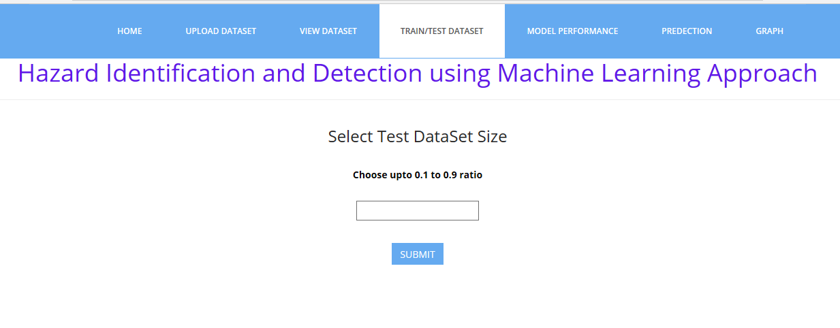
Train/test dataset size

Slide 16
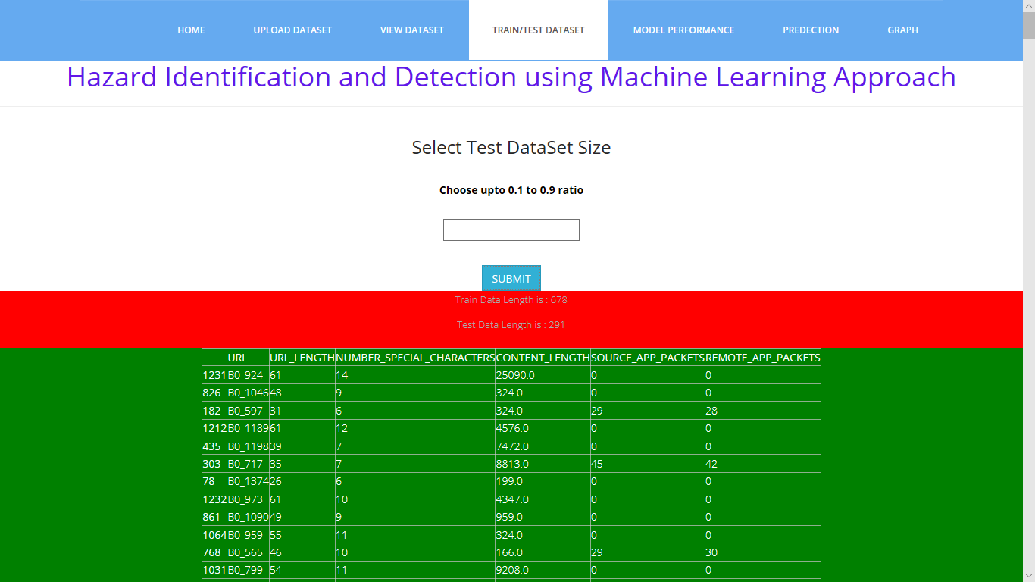
Train/test dataset

Slide 17
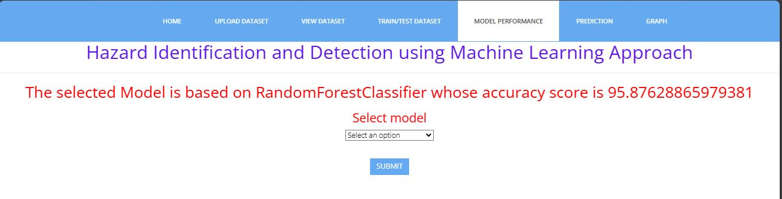
Model performance

Slide 18
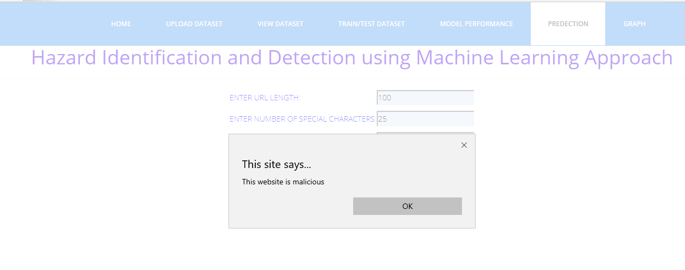
Prediction

Slide 19
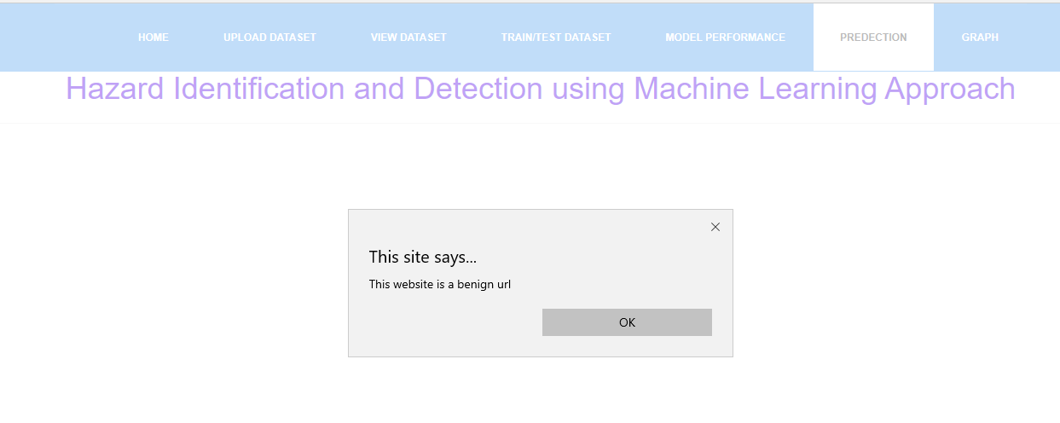

Slide 20
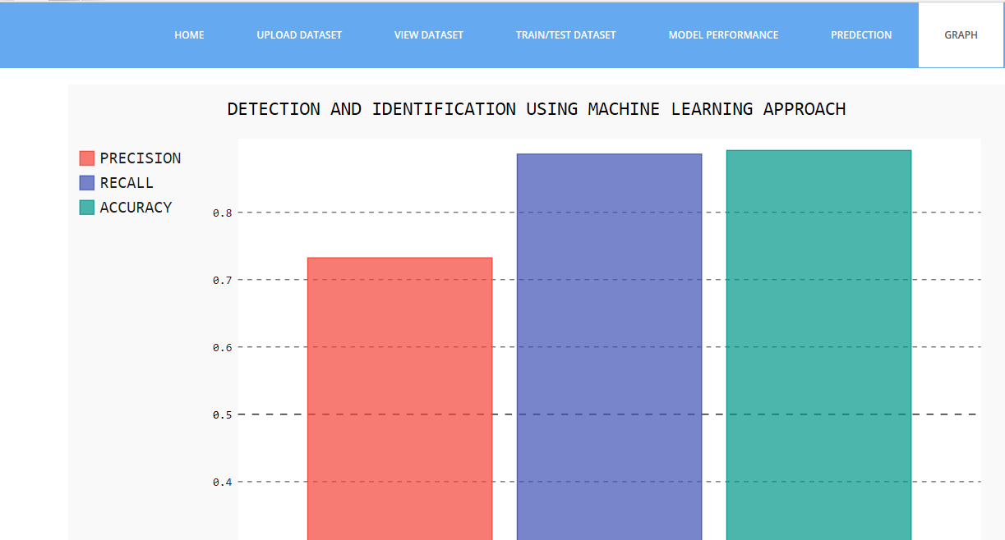
Graphs

Slide 21
Conclusion
Malicious web page identification is an emerging topic in cybersecurity. Though several research studies have been performed relating to the issues of malicious web page detection these are very costly as they consume more time and resources.
In this research, I employed a new web site classification system based on URL features to predict the web pages as malicious or benign using machine learning algorithms.
The machine learning classifiers Random Forest (RF) achieves a higher accuracy of 95%. The experimental results have shown that this method can perform effectively for detecting the malicious web page.

Slide 22
Future work
In future work, It has been planned to expand the feature sets and analysis using various sources of data to enhance the classifier performance.

Slide 23
Thank You

